Slide 1
IP地址

Slide 2
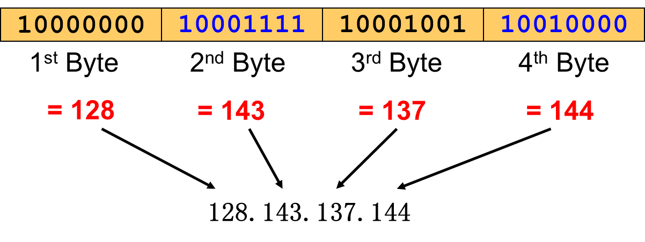
IP Address

Slide 3
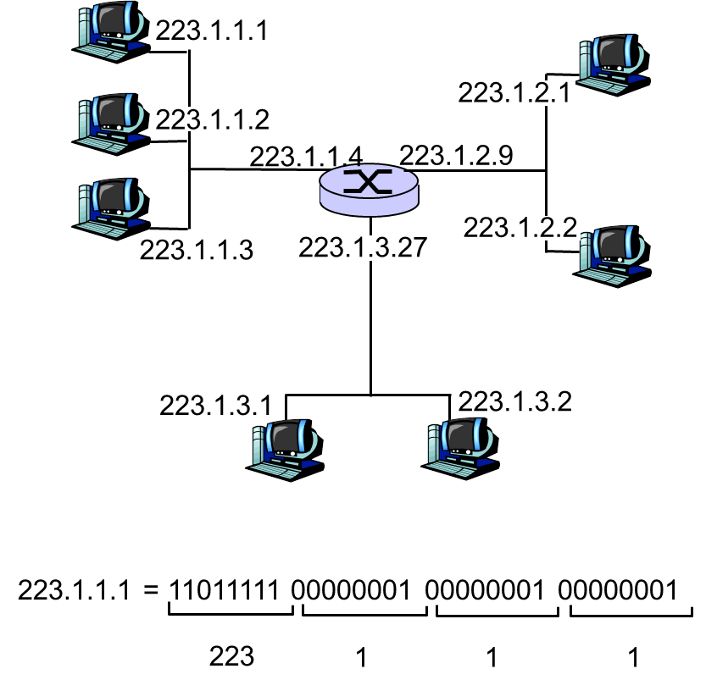
IP Addressing: introduction
IP address: 32-bit identifier for host, router interface
interface: connection between host/router and physical link
router’s typically have multiple interfaces
host typically has one interface
IP addresses associated with each interface

Slide 4
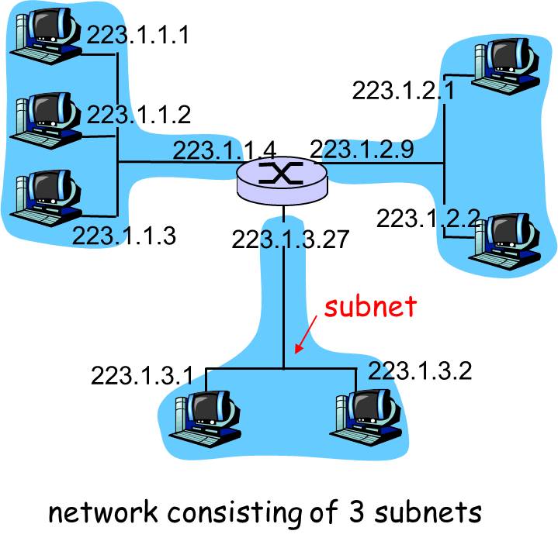
Subnets
IP address:
subnet part (high order bits)
host part (low order bits)
What’s a subnet ?
device interfaces with same subnet part of IP address
can physically reach each other without intervening router

Slide 5
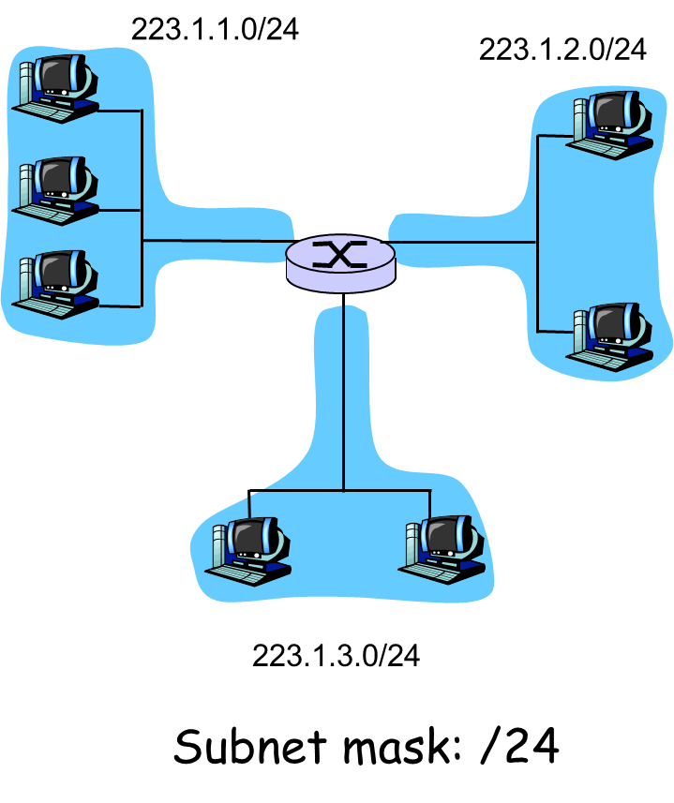
Subnets
Recipe
To determine the subnets, detach each interface from its host or router, creating islands of isolated networks. Each isolated network is called a subnet.

Slide 6
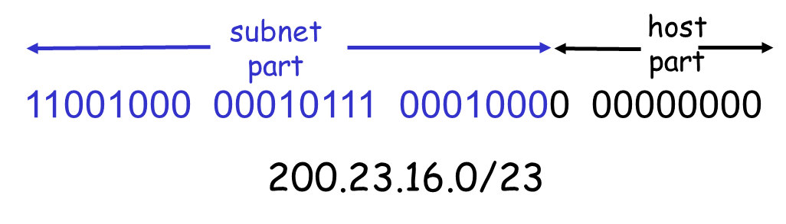
IP addressing: CIDR
CIDR: Classless InterDomain Routing
subnet portion of address of arbitrary length: VLSM (Variable Length Subnet Masking )
address format: a.b.c.d/x, where x is # bits in subnet portion of address

Slide 7
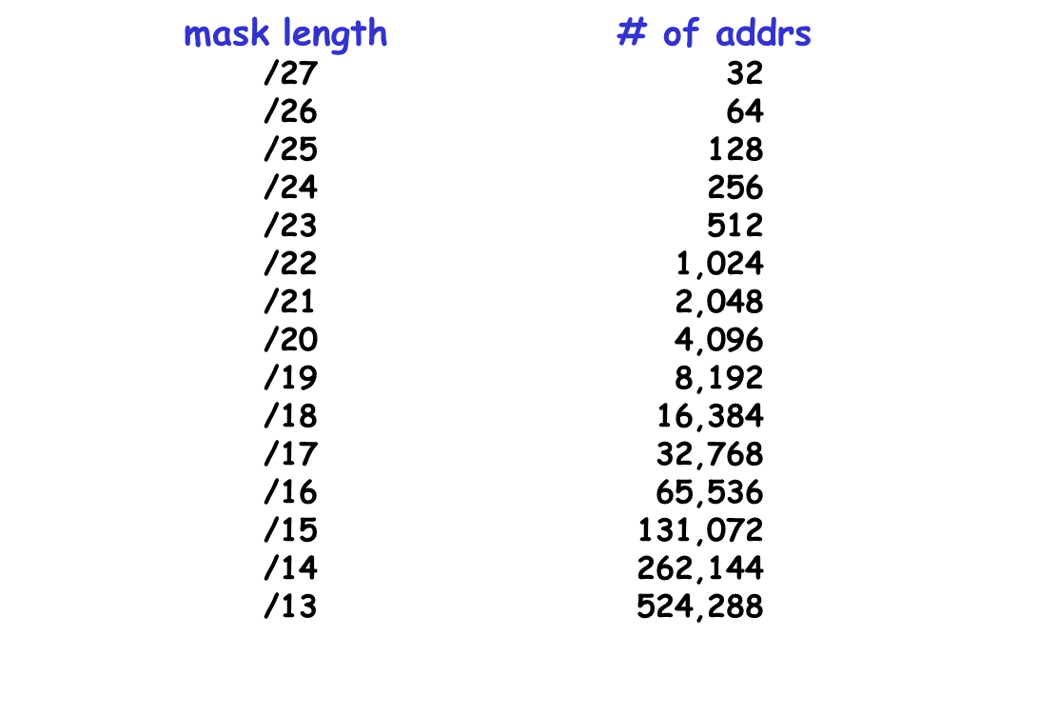
VLSM
# of IP addrs w.r.t. length of network mask:

Slide 8
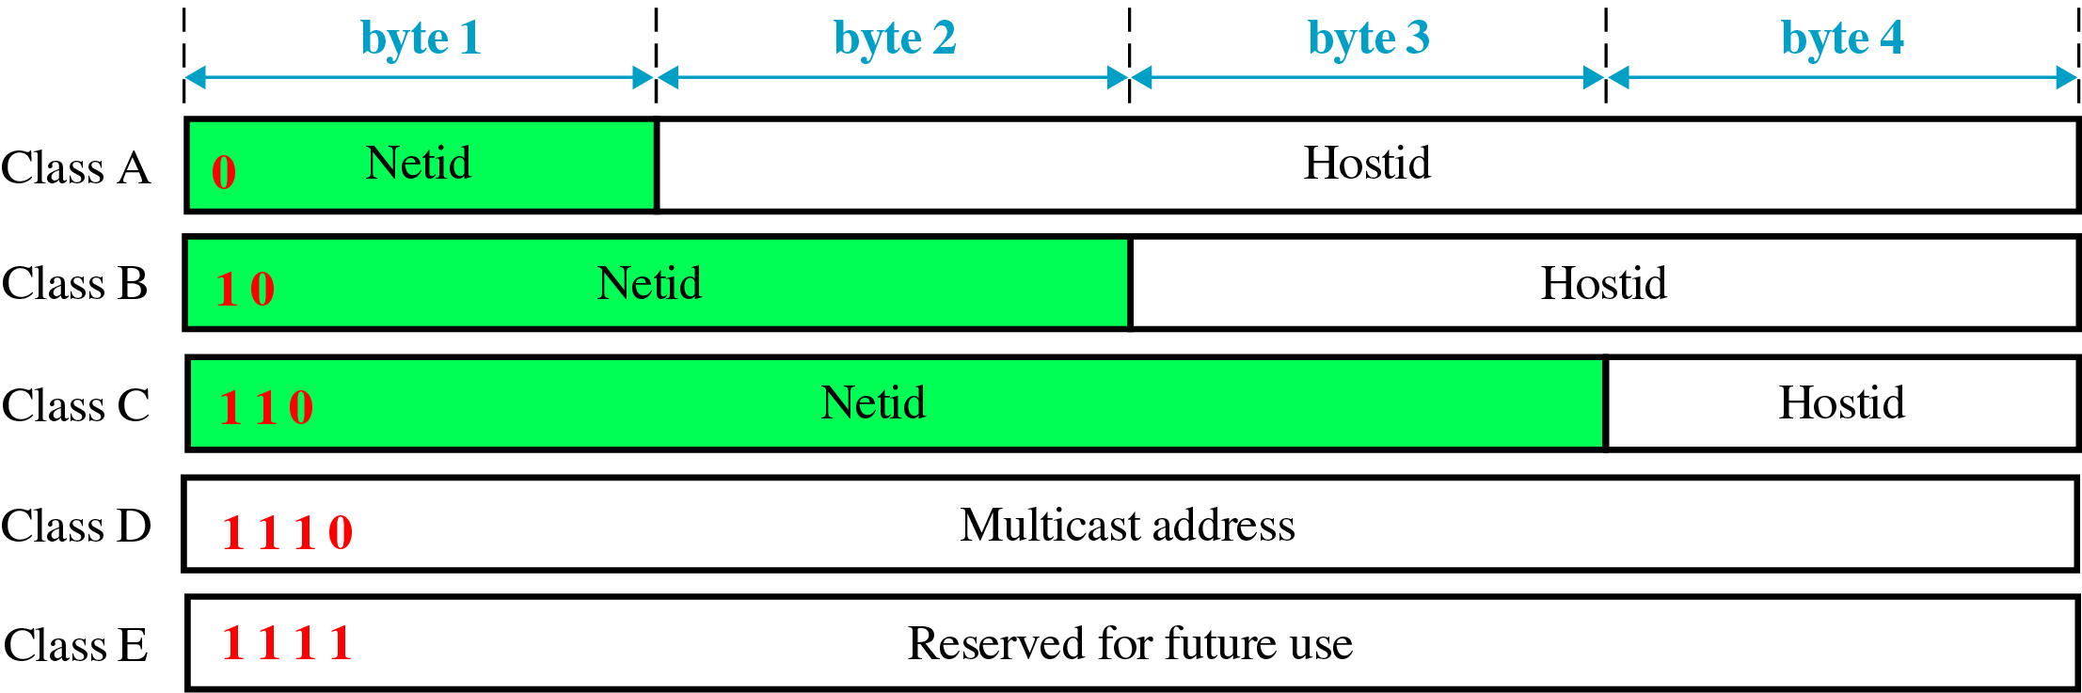
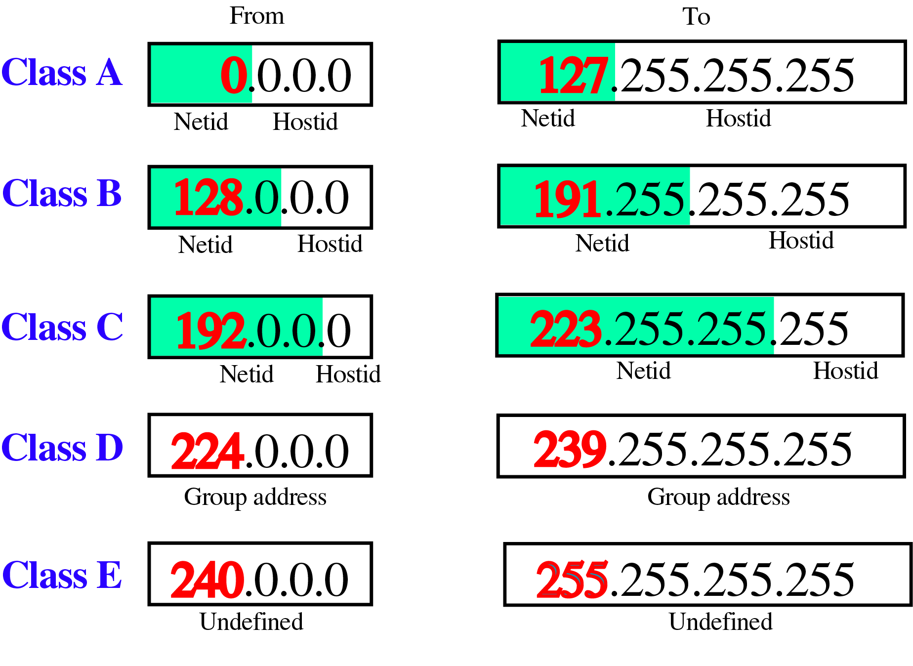
Classful addressing

Slide 9
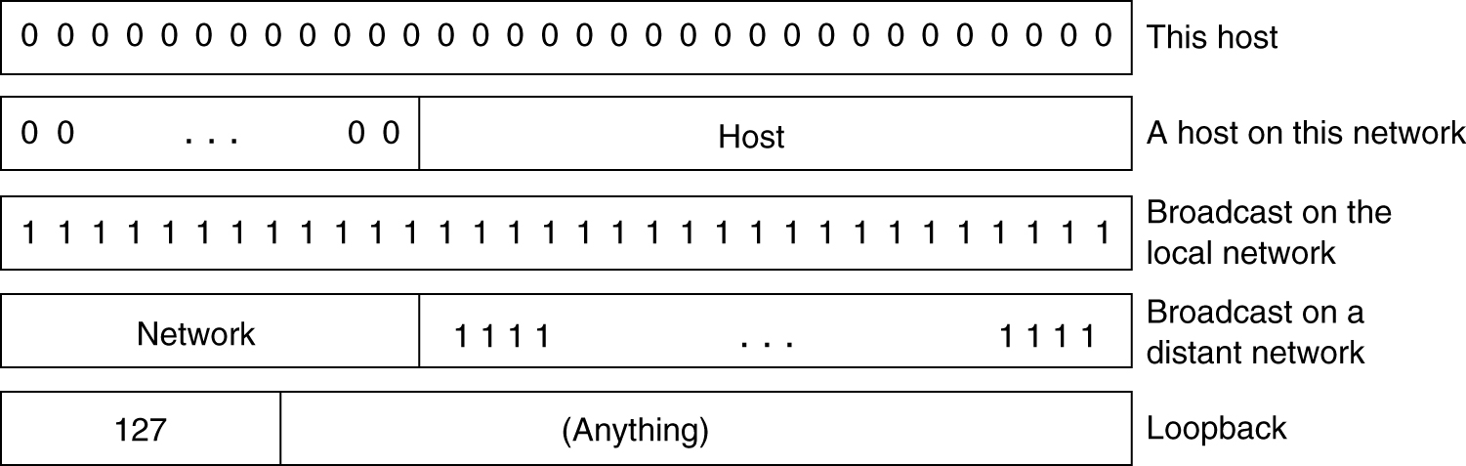
Special IP

Slide 10
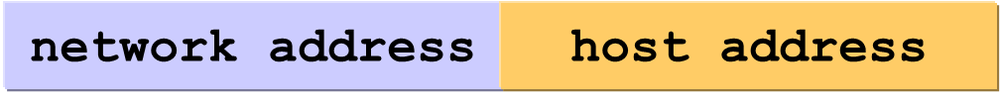
IP address
How to identify?
Explicit: VLSM
Implicit: Classful

Slide 11
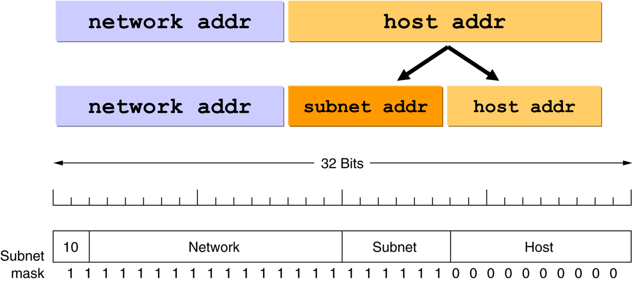
Subnets
A class B network subnetted into 64 subnets
→ VLSM

Slide 12

Summary
IP Addressing
Subnets

